Slide 1
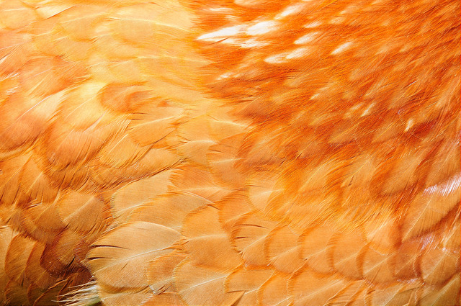
High-throughput proteomics on the DPSF: non-stop searches and the quest for zombie chicken genes
simon.hubbard@manchester.ac.uk
Division of Evolution and Genomic Sciences
School of Biological Sciences
Faculty of Biology, Medicine and Health

Slide 2

The hunt for the zombie chicken (genes)

Slide 3
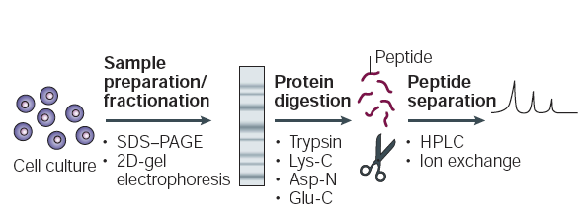
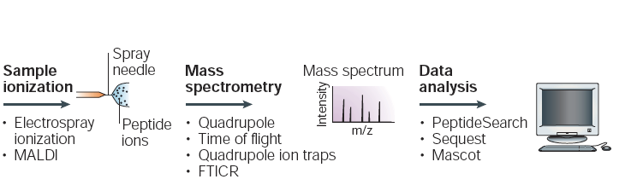
A generalised proteomics experiment
Various routes through this map
Complexity reduction
Separating by size or charge in most cases
Identify peptides as a proxy for proteins, comparing theoretical to experimental spectra

Slide 4
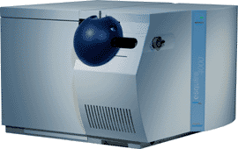
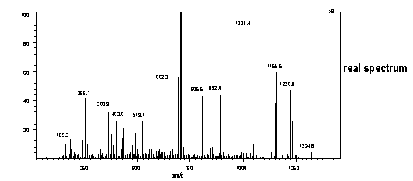
Tandem MS: Basic principles
A.k.a. "Shotgun" proteomics
DDA, MuDPIT
MS1
MS2
Peptides delivered via LC
Select 1 peptide ion
Computationally demanding step
Genome sequence normally required
Compare with library of theoretical peptide spectra
SEQUEST, MASCOT, X!TANDEM, PHENYX, OMSSA, ANDROMEDA, InsPecT, etc.
.....
.....

Slide 5

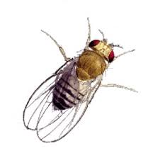
Two examplar projects
Chicken genome annotation
  "Proteogenomics" problem
  403K MS spectra collected from collaborators
  DT40 cell line
  Multiple genome versions throughout time
  How do protein annotations with matching spectra vary over time?
Stop codon readthrough
  Large numbers of fruit fly mass spectral data sets
    22+
  14.8 Million spectra in total
  Only 2 databases
    Standard + Custom DB
  Do we see evidence for readthrough?
    Literature suggests ~640 likely cases

Slide 6
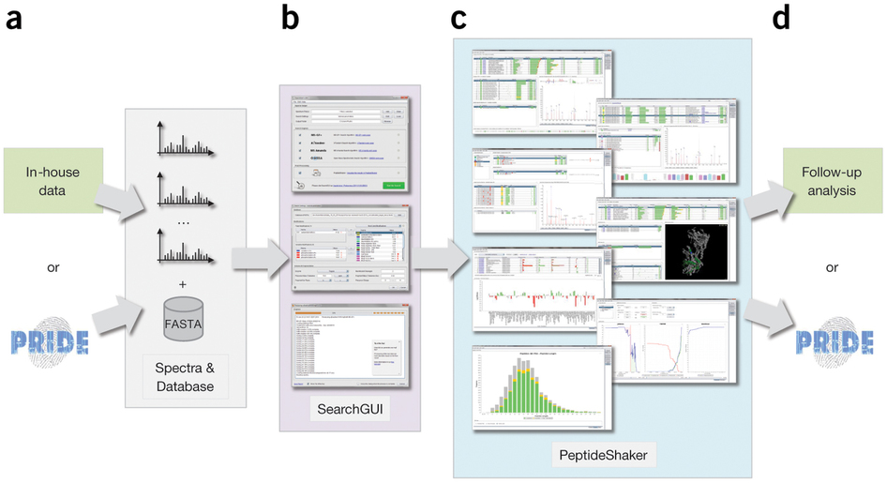
PSMs, peptide and protein "identification"
SearchGUI
PeptideShaker
Two steps need for PSMs/peptide/protein detection
Mass spectra
Search Engines (multiple)
Data integration and Statistics
3rd Party too – Java implementation using Apache Derby RDBM

Slide 7
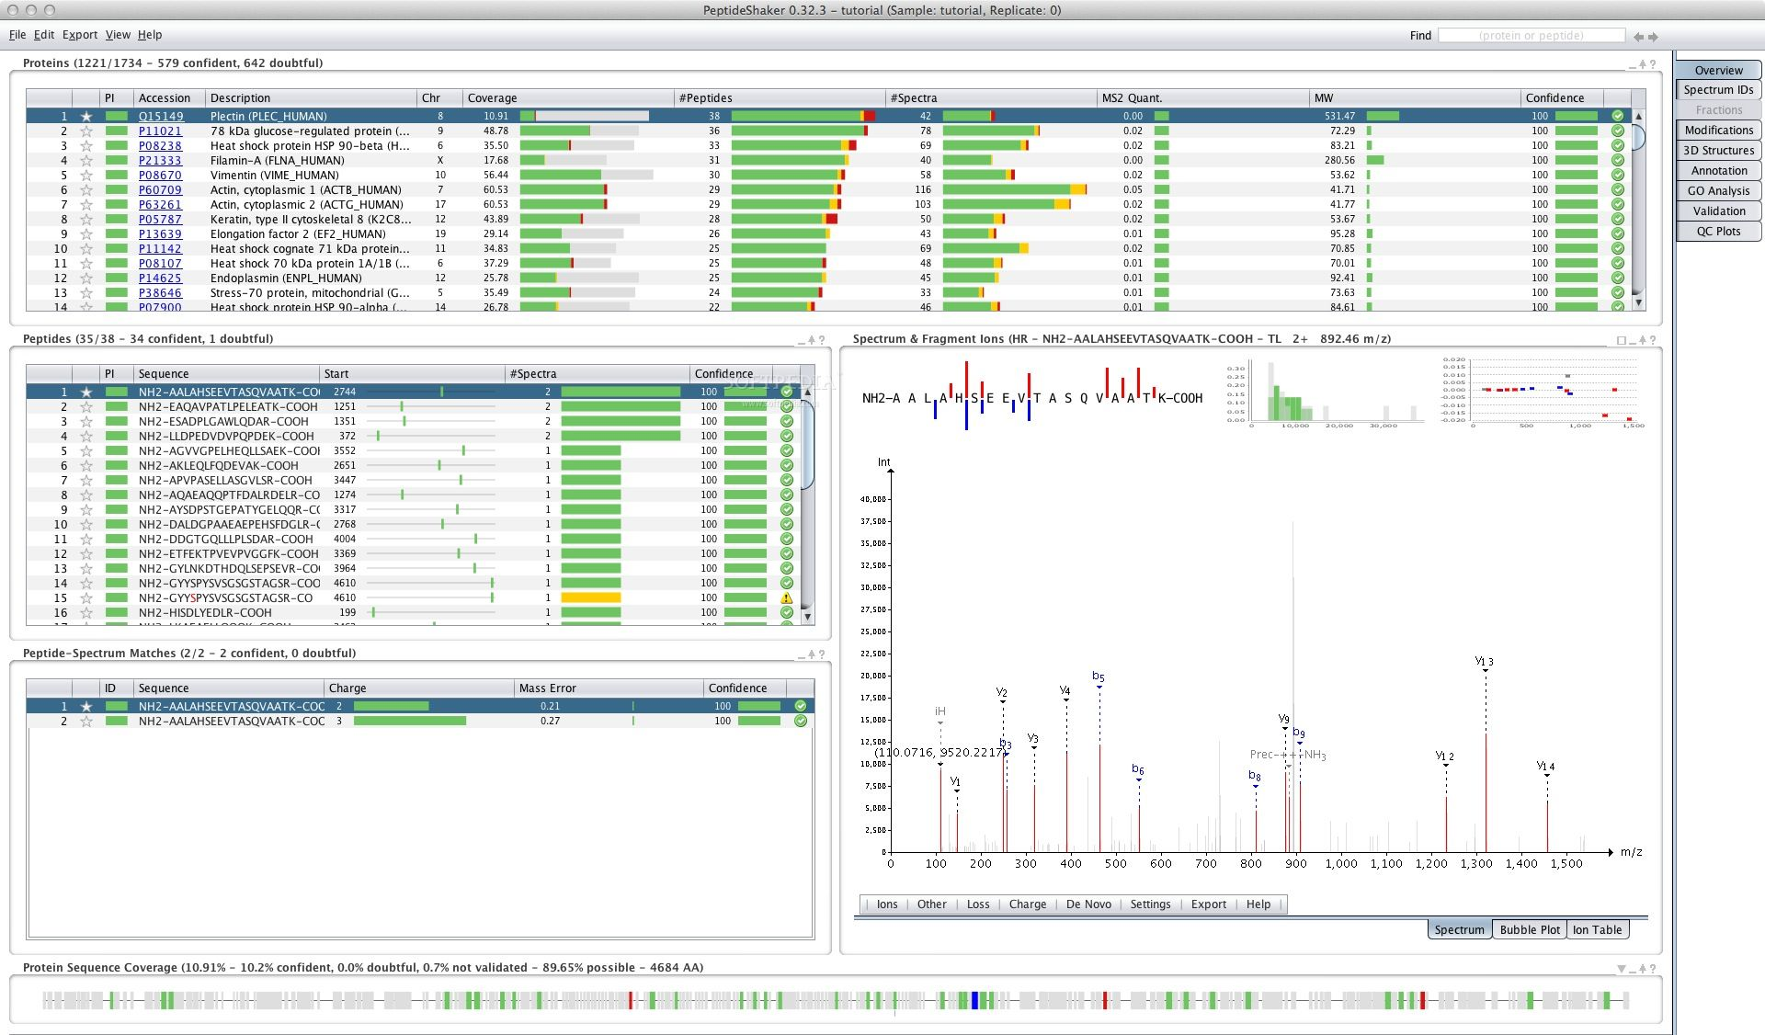
SearchGUI/PeptideShaker

Slide 8
Why DPSF?
Jobs take too long on local workstations …
  Example: 1 "search" + Shaking: Ensembl40, 403K spectra, 4 SE
High-end workstation searches
Intel® Xeon(R) CPU E5-1620 0 @ 3.60GHz × 8 & 32GB memory
1 search vs Ensembl40 DB
  real 275m40.267s
  user 1283m5.780s
  sys 25m59.280s
Peptide Shaker step
  Ran out of memory …
DPFS
20 + 10 nodes, 512 GB RAM & 2* 8-core CPUs (e.g. E5-2640 v3, 2.6GHz)
1 search vs Ensembl40
  real 305m17.137s
  user 2107m29.527s
  sys 227m22.429s
Peptide Shaker step
  real 570m34.824s
  user 366m34.914s
  sys 5563m37.231s
Shaker is memory hungry. Both tools use Java Apache Derby RDB management

Slide 9

Why DPSF?
Jobs take too long on local workstations …
  Example: 2 "search" + Shaking: FlyBase5.5, 200K-2M spectra, 1 SE
High-end workstation searches
Intel® Xeon(R) CPU E5-2687W v2 @ 3.40GHz × 16 & 64GB memory
1 search vs FlyBase5.5 DB
  real 192m44.377s
  user 750m11.486s
  sys 64m53.120s
Peptide Shaker step
  Ran out of memory …
DPFS
20 + 10 nodes, 512 GB RAM & 2* 8-core CPUs (e.g. E5-2640 v3, 2.6GHz)
1 search vs FlyBase5.5 DB
  real ~180m
Peptide Shaker step
  Real ~280m
Shaker is memory hungry. Both tools use Java Apache Derby RDB management

Slide 10
Implications
Chickens ….
  1 sample
  35 databases (~48K seqs)
  2 x Search engine combinations
  2 parameter combos
  84000 mins (~58 days)
  DPSF (2-3 days)
Flies
  22 samples
  2 databases (~43K seqs)
  1 x Search engine combos
  1 x parameters combos
  18000 mins (~12 days)
  DPSF (1-2 days)

Slide 11
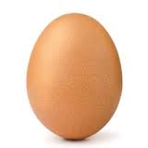

Birth, life and death of a gene
DNA sequence,
Assembly,
Genome
New data, cDNAs, orthologues, other genomes
New DNA sequence,
Assembly,
Genome
New data, cDNAs, orthologues, other genomes
New DNA sequence,
Assembly,
Genome
Initial gene prediction, annotation
Year 0
Year 1
Year 2
Year 3
Year 4
Year 4
Year 5
Year 6
Year 7
Year 8
Progress in genome annotation
Gene_X
Gene_X
Gene_X
Gene_X
Gene_X'
Gene_X'
Gene_X''
Gene_X''
Gene_X''
proteins
1
2
3
1
2
3
1
3
1
3
2
4
2
4
2
5
2
5
2
5
Gene_Y
Gene_Y
Gene_Y
Gene_Y
Gene_Z
Gene_Z
Gene_Z
Gene_Z
*plus actually more complicated at protein level

Slide 12
Evolution of chicken genome annotation
18,632
15,508
24,168
16,354
2004
2015

Slide 13
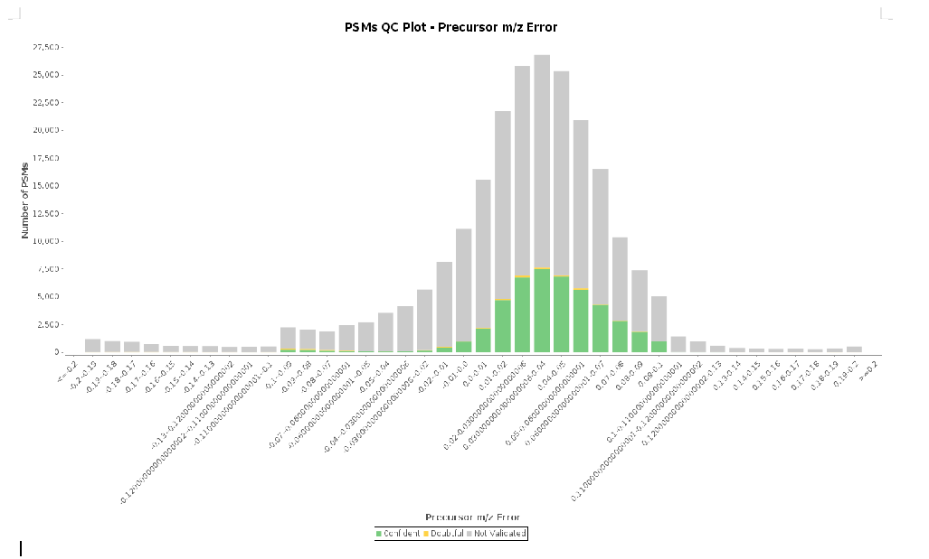
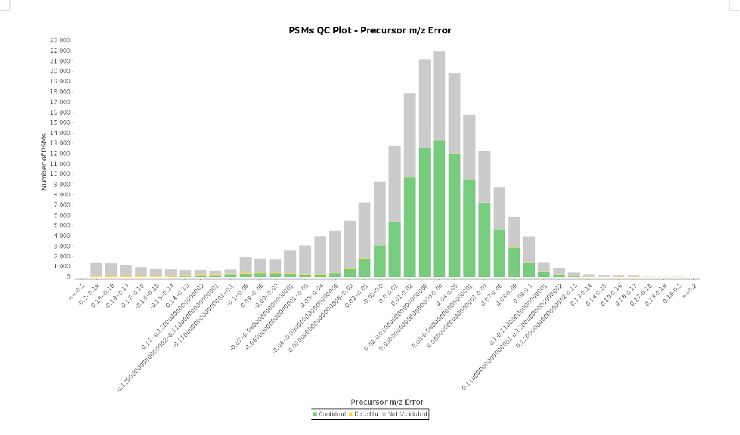
Testing out mass spec parameters
2 SE- MS-GF+ , OMSSA
4SE= X! Tandem,Myrimatch, Comet,Tide
Precursor Ion Tolerance: 0.2Da
Fragment Ion tolerance: 1.0 Da

Slide 14
Proteome peptide coverage
Ens41 Ens42
Ens70 Ens71
old
new
old
new
844 5570 876
829 5582 1036
153
691
420
456
162
667
480
556
Not in both DBs
Not in both DBs
Not in both DBs
Not in both DBs

Slide 15
Disappearing peptide
NLGSINTELQDVQR, present in Ens41, lost in Ens42
ENSGALP00000004591 MVLLTMIARVADGLPLAASMQEDEQPVLSPQSGRDLQQYQSQAKQLFRKL
ENSGALP00000004591_1 MVLLTMIARVADGLPLAASMQEDEQ------SGRDLQQYQSQAKQLFRKL
************************* *******************
ENSGALP00000004591 NEQSPTRCTLEAGAMAFHYIIEKGVCYLVLCEAAFPKKLAFAYLEDLQSE
ENSGALP00000004591_1 NEQSPTRCTLEAGAMAFHYIIEKGVCYLVLCEAAFPKKLAFAYLEDLQSE
**************************************************
ENSGALP00000004591 FDEQHGKKVPTVSRPYSLKRFDTYIQKTKKLYIDSRARRNLGSINTELQD
ENSGALP00000004591_1 FDEQHGKKVPTVSRPYS---------------------------------
*****************
ENSGALP00000004591 VQRIMVANIEEVLQRGEALSALDSKANNLSSLSKKYRQDAKYLNMRSTYA
ENSGALP00000004591_1 --------------------------------------------------
ENSGALP00000004591 KLAAVAVFFIMLIVYVRFWWL
ENSGALP00000004591_1 ---------------------

Slide 16
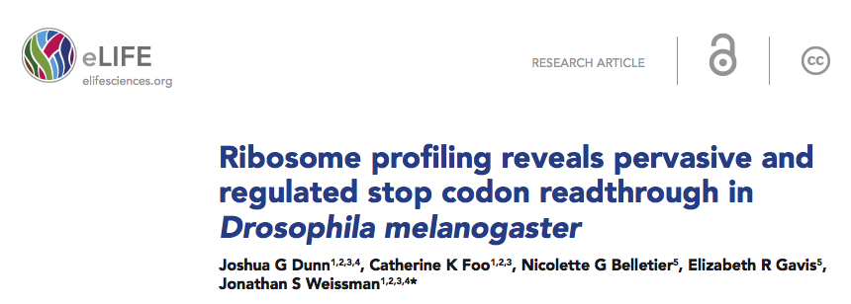
Stop codon readthrough
Normally, translational machinery stops at standard codons in genetic code (TAG, TAA, TGA)
Exposes novel C-terminal protein elements
Involved in:
  Viral protein function, Tissue specificity, Development, and can provide fitness advantages
Recently proposed to be be extensive in Drosophila

Slide 17
Stop codon search model
640 predicted RTs
Mass spectrometry data
Editing fasta database to add RT possibilities
AYAA
VYNYLAYAA
X
STOP?
Insert artificial stops (X) where peptides are detected for 50 proteins as test cases
AYAA
VYNYL
C
AYAA
VYNYL
R
AYAAS
VYNYLAYA
STOP
AYAA
VYNYL
S
AYAA
VYNYL
STOP
W
AYAA
VYNYL
Simulated fasta database for validation
Mass spectrometry search on
expanded fasta database

Slide 18
Stop codon search results
StandardDB ReadThroughDB Difference Stop RT Genes Spectra
 | peptides | genes | peptides | genes | peptides | genes | peptides | genes | RT genes with MS evidence | MS/MS Spectra
10 Fraction | 39171 | 4275 | 39148 | 4283 | -23 | 8 | 0 | 0 | 312 | 336,165
35 Fraction | 81434 | 7512 | 81490 | 7530 | 56 | 18 | 13 | 11 | 454 | 1,022,206
Body | 38707 | 4411 | 38745 | 4411 | 38 | 0 | 2 | 1 | 232 | 1,676,850
Head | 40741 | 4415 | 40680 | 4414 | -61 | -1 | 33 | 12 | 269 | 1,550,808
Heatshock T0 | 34863 | 3700 | 34854 | 3701 | -9 | 1 | 1 | 1 | 283 | 304,553
Heatshock 30mins | 38588 | 4105 | 38600 | 4111 | 12 | 6 | 1 | 1 | 296 | 337,343
Heatshock 1h | 35951 | 3959 | 35991 | 3960 | 40 | 1 | 1 | 1 | 298 | 327,733
Heatshock 3h | 35363 | 3890 | 35383 | 3893 | 20 | 3 | 2 | 2 | 280 | 323,815
Glu-C | 5899 | 1870 | 5867 | 1862 | -32 | -8 | 2 | 2 | 119 | 2,180,414
Chymotrypsin | 9357 | 2931 | 9139 | 2859 | -218 | -72 | 1 | 1 | 200 | 2,218,117
WT head Trypsin | 66341 | 6543 | 66425 | 6540 | 84 | -3 | 78 | 37 | 414 | 531,709
WT head Glu-C | 6057 | 1762 | 5955 | 1731 | -102 | -31 | 3 | 3 | 107 | 453,789
WT head Chymotrypsin | 18750 | 3422 | 18683 | 3471 | -67 | 49 | 14 | 11 | 222 | 533,715
Eyeless head Trypsin | 69022 | 6880 | 69109 | 6886 | 87 | 6 | 85 | 41 | 425 | 532,448
Eyeless head Glu-C | 11826 | 2816 | 11832 | 2816 | 6 | 0 | 13 | 9 | 182 | 487,580
Eyeless head Chymotrypsin | 19866 | 3744 | 19726 | 3638 | -140 | -106 | 16 | 8 | 249 | 542,282
Lumos WT head Trypsin | 71933 | 6876 | 72007 | 6882 | 74 | 6 | 90 | 43 | 436 | 305,571
Lumos WT head Glu-C | 5206 | 1676 | 5122 | 1631 | -84 | -45 | 3 | 2 | 100 | 97,438
Lumos WT head Chymotrypsin | 18061 | 3728 | 17909 | 3610 | -152 | -118 | 18 | 11 | 233 | 308,058
Lumos Eyeless head Trypsin | T.B.D. | T.B.D. | T.B.D. | T.B.D. | T.B.D. | T.B.D. | T.B.D. | T.B.D. | T.B.D. | 312,506
Lumos Eyeless head Glu-C | 7774 | 2081 | 8050 | 2267 | 276 | 186 | 10 | 7 | 143 | 155,887
Lumos Eyeless head Chymotrypsin | 17914 | 3836 | 17894 | 3800 | -20 | -36 | 14 | 8 | 240 | 330,094
Peptide evidence for RT section of 70 of 640 predictions
  Not too many => much less stop RT than predicted?
Notes:
~250-450 RT proteins detected per sample with evidence for protein but not for RT region

Slide 19


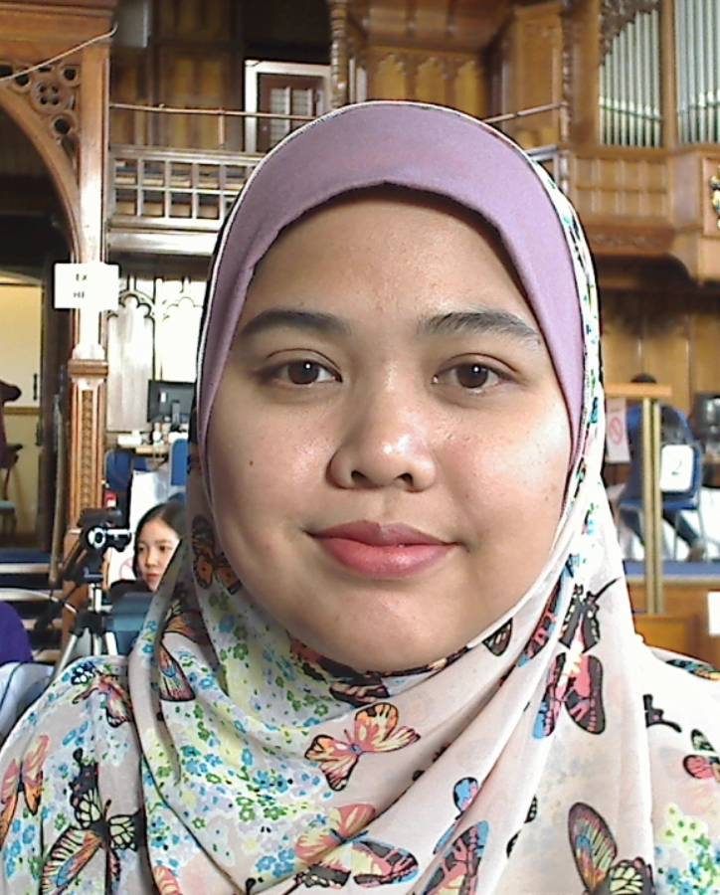
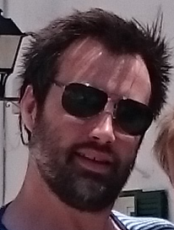
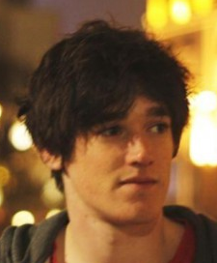

Acknowledgements
Research IT for DPSF
Norazrin Ariffin
Craig Lawless
Michael Nelson
MS data
Kathryn Lilley, Steve Russell, Dagmara Korona, Dan Nightingale, Bertrand Fabre (Cambs)
+ rest of Hubbard lab

